Slide 3
Who We Are
http://www.weather.gov/seattle

Slide 4
Local Office Operations - Area of Responsibility
Population - 4.5 million
Registered boats - 300,000
(greater than 16 ft)
14 counties west of the Cascade crest, plus
Strait of Juan de Fuca, Puget Sound, Hood
Canal, and San Juan Islands, and Coastal
Waters out 60 nautical miles

Slide 5
Aviation

Slide 6
Center Weather Service Unit (CWSU)
Coordination:
- 6:00 am in-brief from WFO Seattle shift team leader
- 9:30 am coordination call prior to issuance of SEA TAF (hub)
- other times as needed, e.g., SEA TAF amendment
- 12 Planet

Slide 7
Hydrology Program

Slide 8
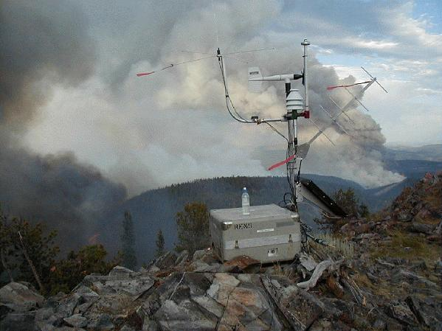
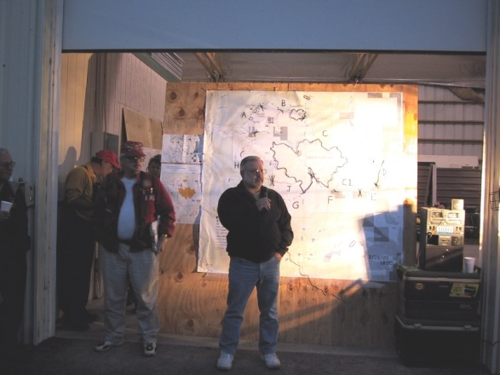
Fire Support
IMETs (ERS)
Highly trained in Fire Behavior, NFDRS and ICS.
Knowledgeable in the care and use of PPE.
Weather self-sufficient (Laptop with 2-way satellite communications).
Fire RAWS with belt weather kits.
Re-certify Annually.
Provide weather for on-site briefings, radio briefings, community meetings, etc.

Slide 9
NWS Support to Non-Weather Hazards

Slide 10
NWS Modernization

Slide 11
Forecast Product Suite
Had changed very little over the previous 50 years
Format:
  Text
  Descriptive
  For large areas, and a small set of specific points
Remarkably little change given dramatic improvements in understanding, observations, and forecast skill

Slide 12
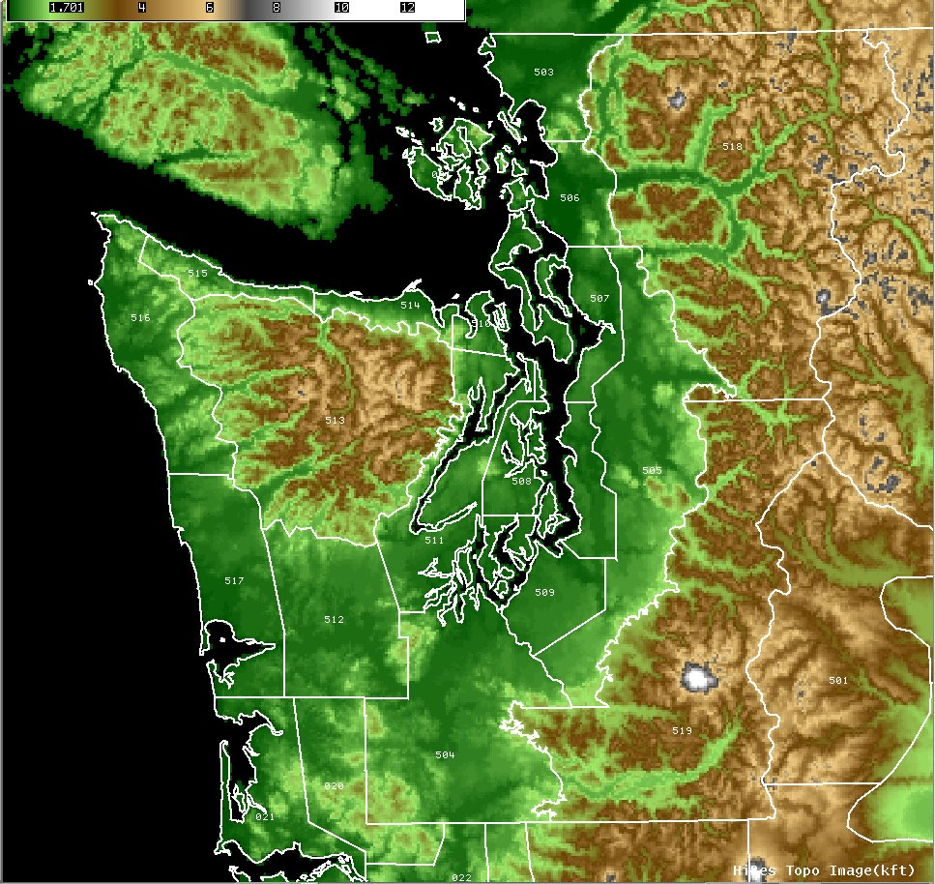
Legacy NWS Zones

Slide 13
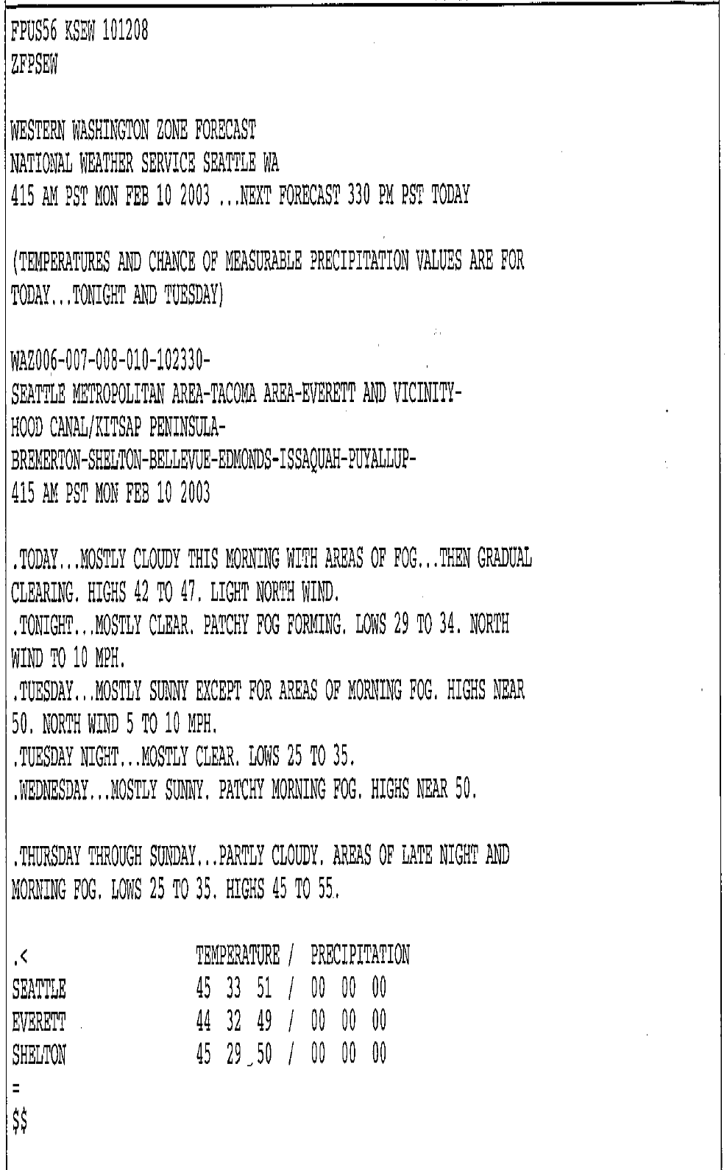
ZONE
SPOT FORECASTS

Slide 14
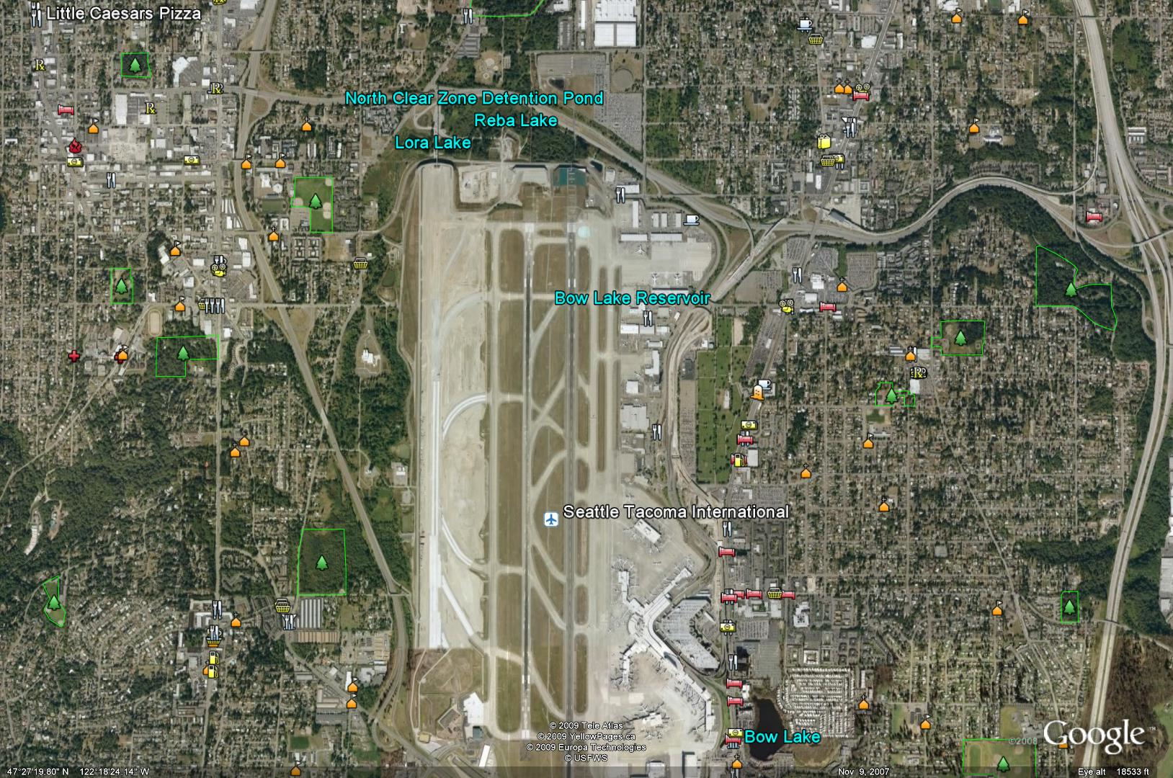

Slide 15
Point Forecasts
A directly measurable metric
Scale incompatibility with NWP models
Most successful approach was to post-process model output to downscale to “point” and to account for model biases
MOS (Model Output Statistics) became the benchmark forecast
Mature and well understood
→ But really didn’t address growing demand for customized weather information

Slide 16
Motivation for Digital Forecasts
Growing demand for area-specific forecasts: “What about my place?”
Continual improvement in NWP skill and understanding
  We know a lot more than we are conveying
Rapid advances in mesoscale NWP

Slide 17
Interactive Forecast Preparation System (IFPS) and National Digital Forecast Database (NDFD)

Slide 18
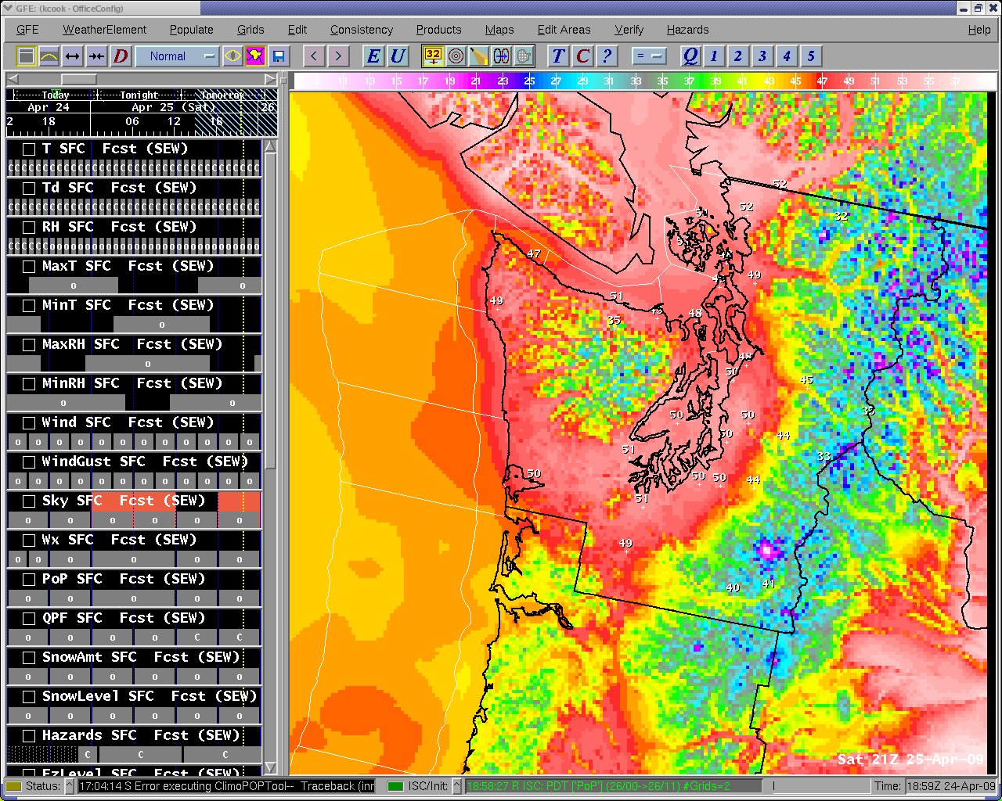
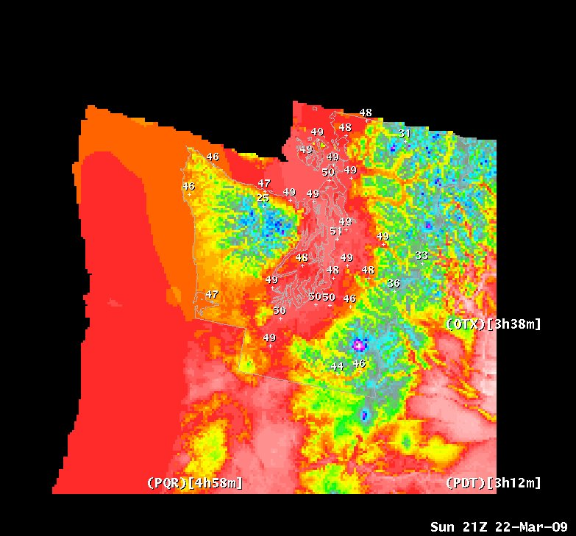
Maximum Temp Forecast

Slide 19
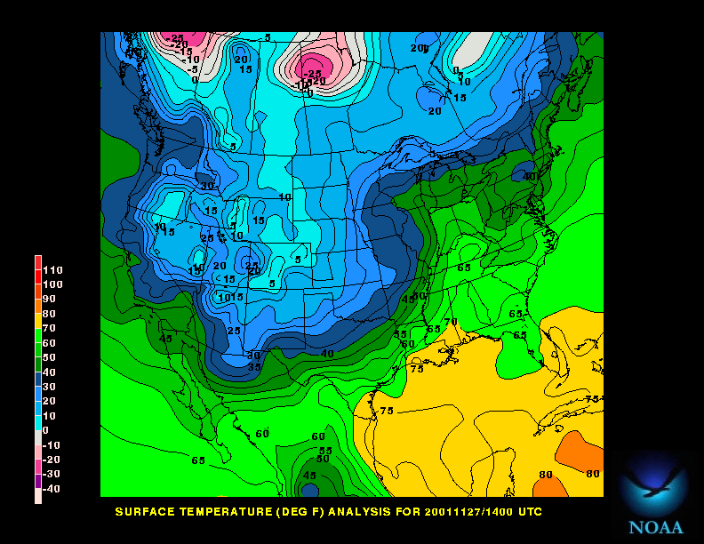
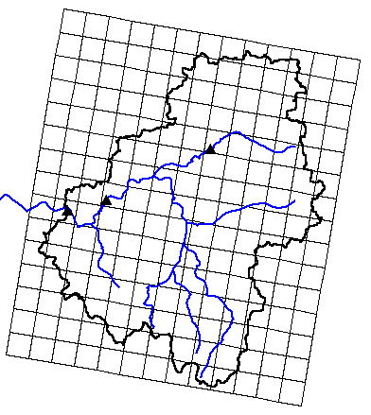
From Text to…..
Digital, Detailed and Graphical
Traditional Process
PARTLY CLOUDY WITH A CHANCE OF SHOWERS. COLDER WITH HIGHS 35 TO 40. SOUTHEAST WIND 5 TO 10 MPH SHIFTING TO THE SOUTHWEST EARLY THIS AFTERNOON. CHANCE OF PRECIPITATION 70%.
TODAY...RAIN LIKELY. SNOW LIKELY ABOVE 2500 FEET. SNOW ACCUMULATION BY LATE AFTERNOON 1 TO 2 INCHES ABOVE 2500 FEET. COLDER WITH HIGHS 35 TO 40. SOUTHEAST WIND 5 TO 10 MPH SHIFTING TO THE SOUTHWESTEARLY THIS AFTERNOON. CHANCE OF PRECIPITATION 70%.
New Forecast Process
EAST SLOPES CASCADES
CLE ELUM
PTCLDY CLOUDY PTCLDY PTCLDY SUNNY PTCLDY 60/52 63/54 65/47 55/40 55/37 50/33
POP 20 POP 20 POP 20 POP 20 POP 10 POP 10

Slide 20
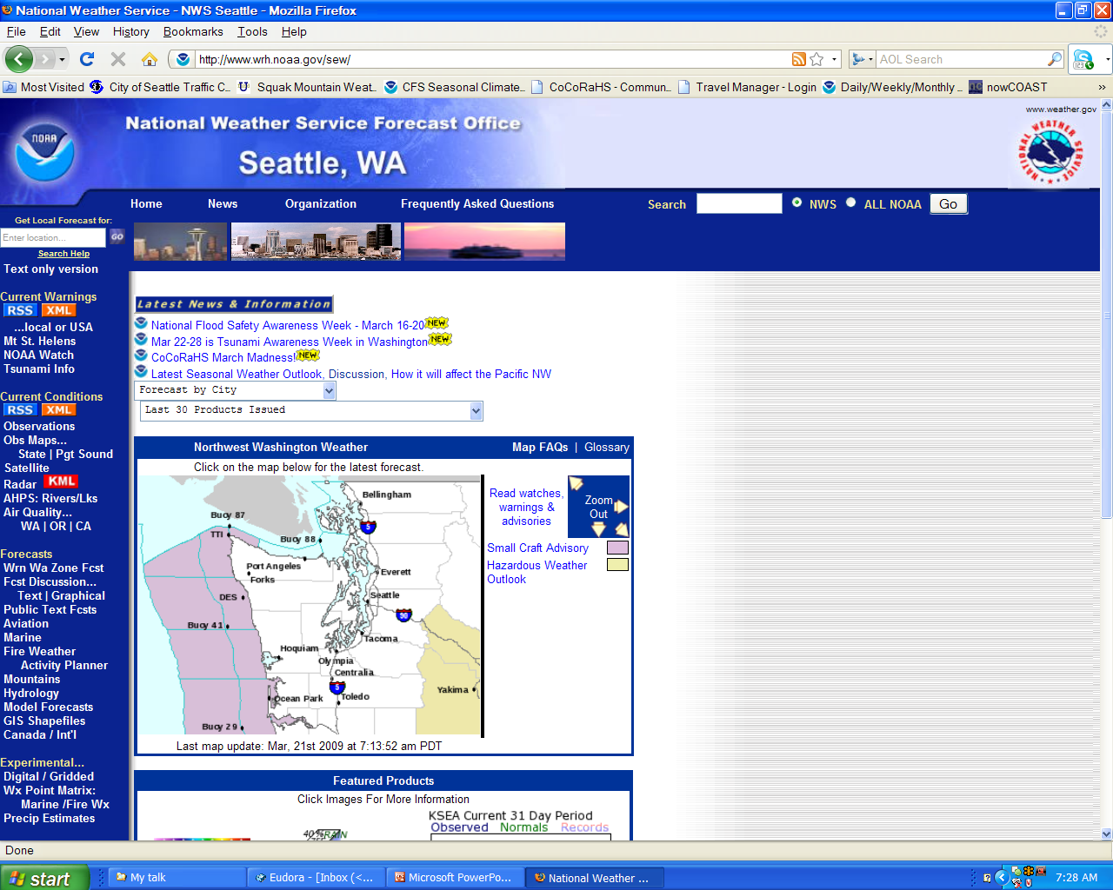
You can click anywhere over the map and get a forecast derived from the 2.5 km grids

Slide 21
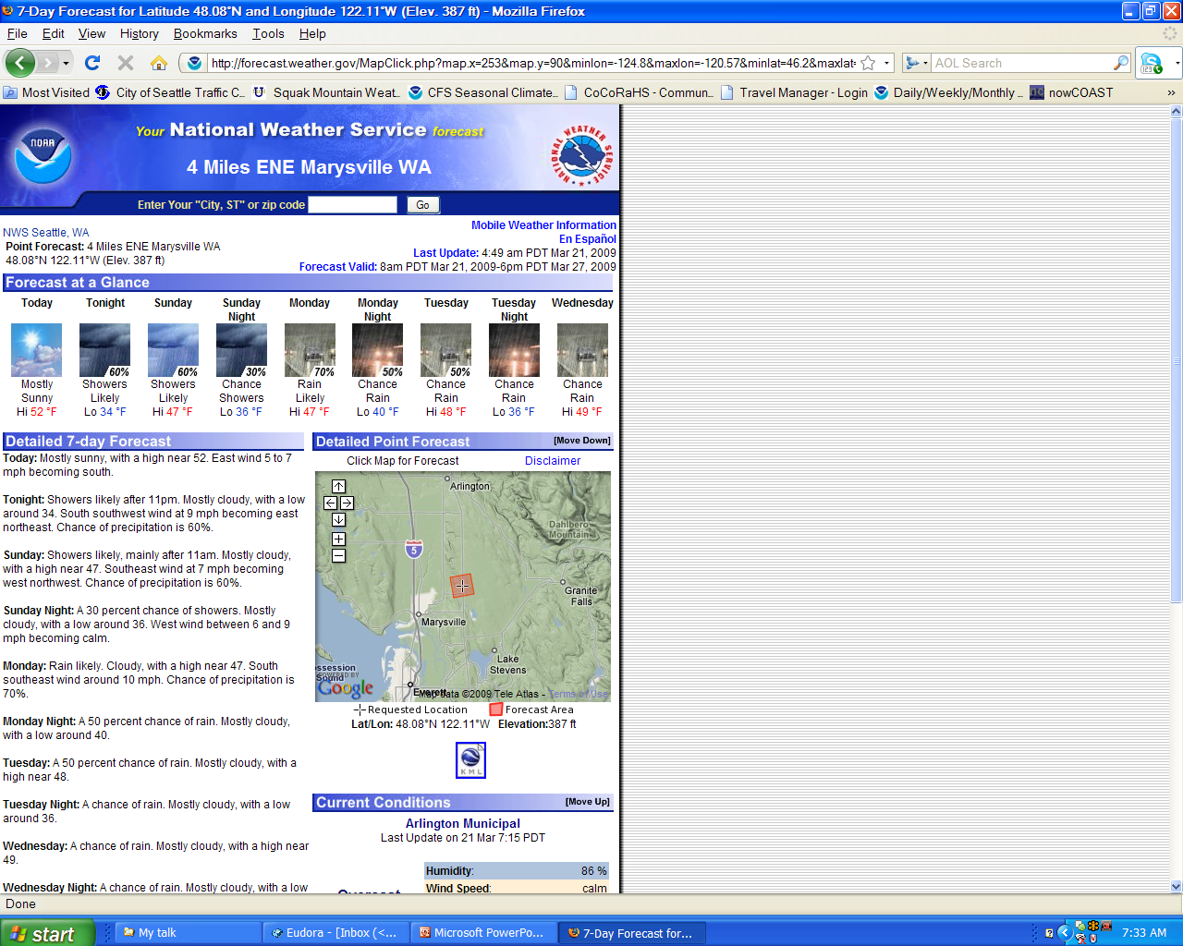
The pixel you select is shown, as well as a derived text forecast

Slide 22
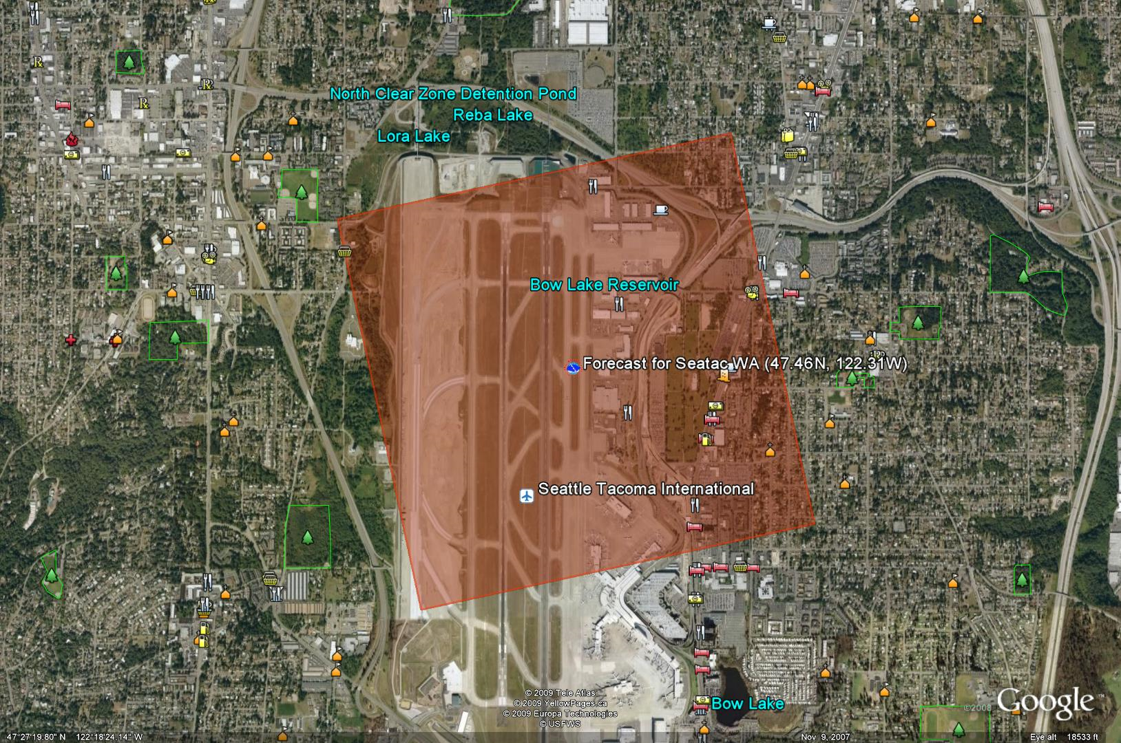
Current “resolution” or “pixelization” of forecast: 2.5 KM²

Slide 23
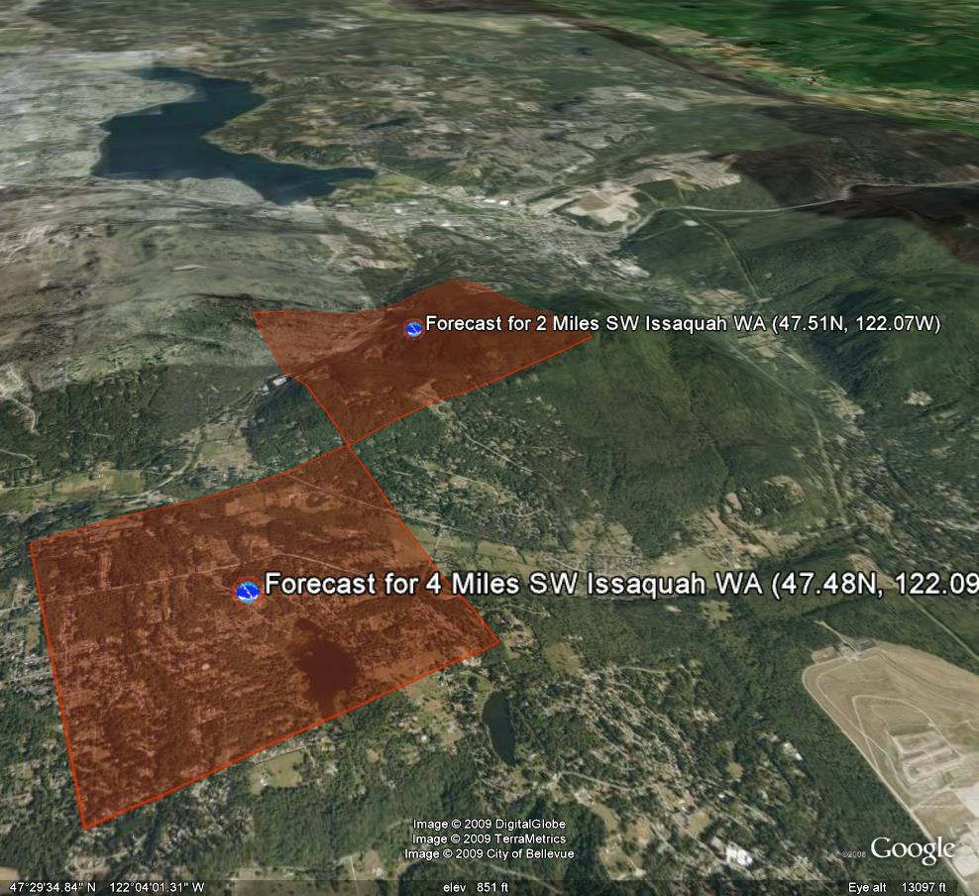
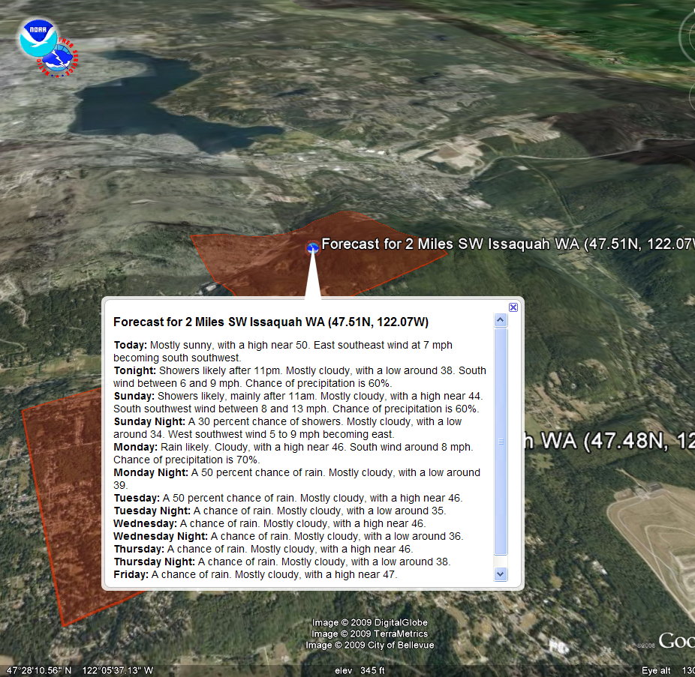

Slide 24
What is Truth?
Unmeasurable quantity
Mesoscale data assimilation and analysis is a modern day challenge
Yet, it is critical if we are to mature the current system

Slide 25
Forecast Uncertainty
Winter Storm 2012

Slide 26
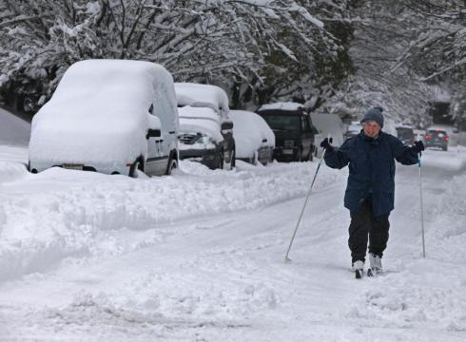
The Snow!!

Slide 27
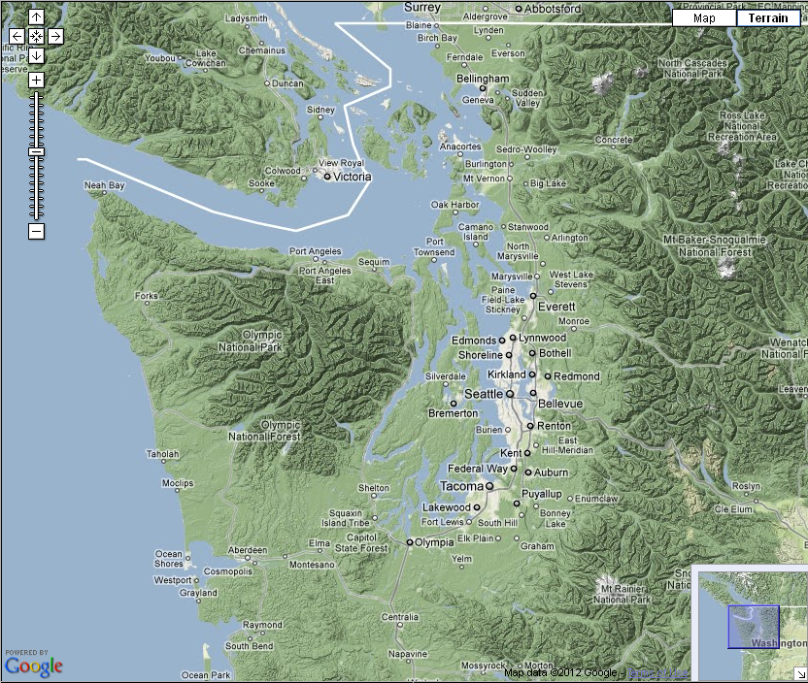
January 18th 2012 Snowfall Totals
4” or less
6+ inches
4” or less
6 to 9”
4” or less
4” or less
8 inch line
10 inch line
14+ inches
12 inch line
Notes:
The snowfall totals are based on spotter and CoCoRahs reports. For the CoCoRahs reports I had to combine totals from the 18th and 19th to cover this event as it crossed 7 am.

Slide 28
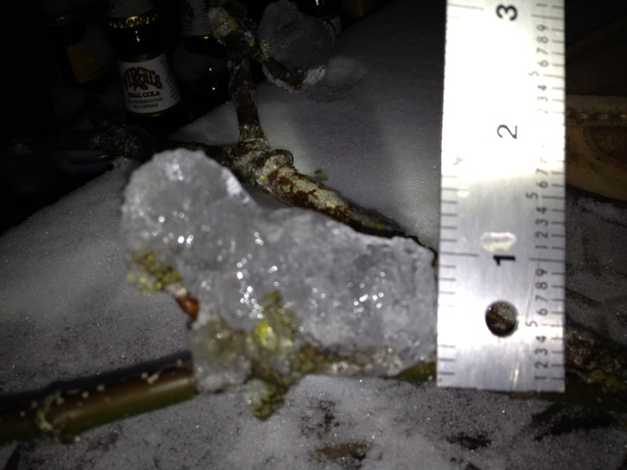
The Ice!!

Slide 29
Approximate Freezing Rain/Drizzle Accumulation from the evening of January 18th through the afternoon of January 19th
0.25 inch
0.50 inch
0.75 inch
1.00+ inches
Notes:
I included the freezing drizzle that started the evening of January 18th and primarily affected the northern portions of the Seattle/Everett metro area where approximately 0.20 ich an inch of drizzle accumulated. The data used was gathered from Cocorahs data, spotter reports and data gleaned from Mesowest. When using the Mesowest data, in some cases the freezing rain was inferred from precipitation accumulation occurring when the temperature was at and below freezing. Data was limited in the area of heaviest precipitation due to power outages. This data should be considered preliminary.

Slide 30
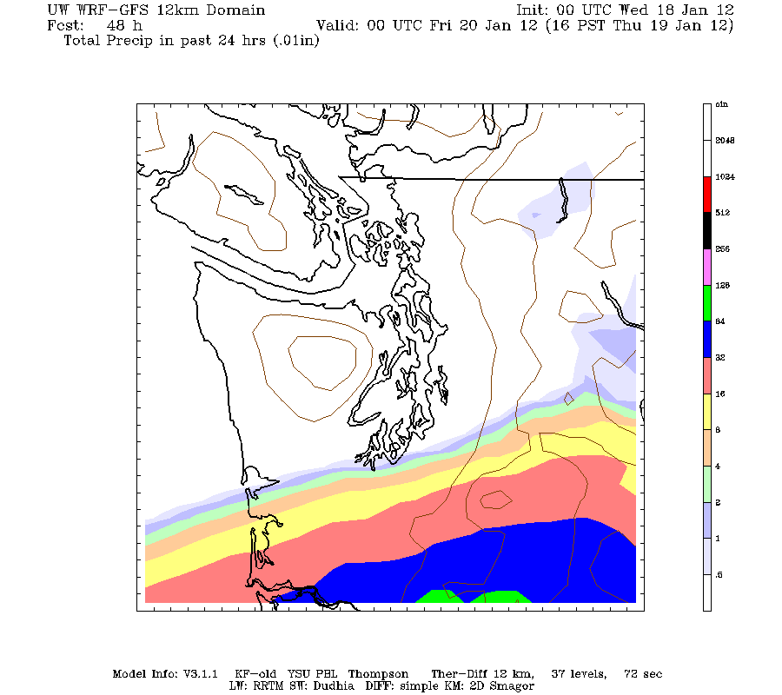
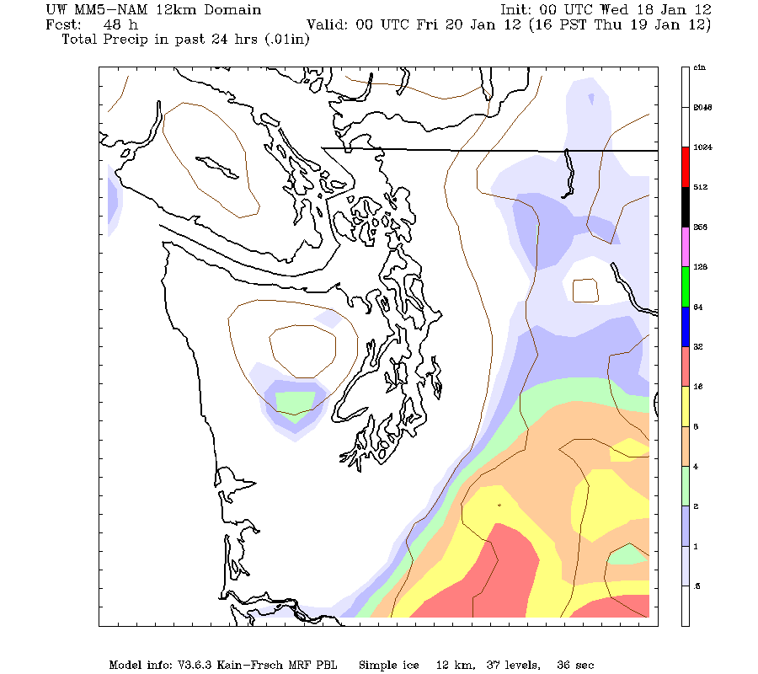
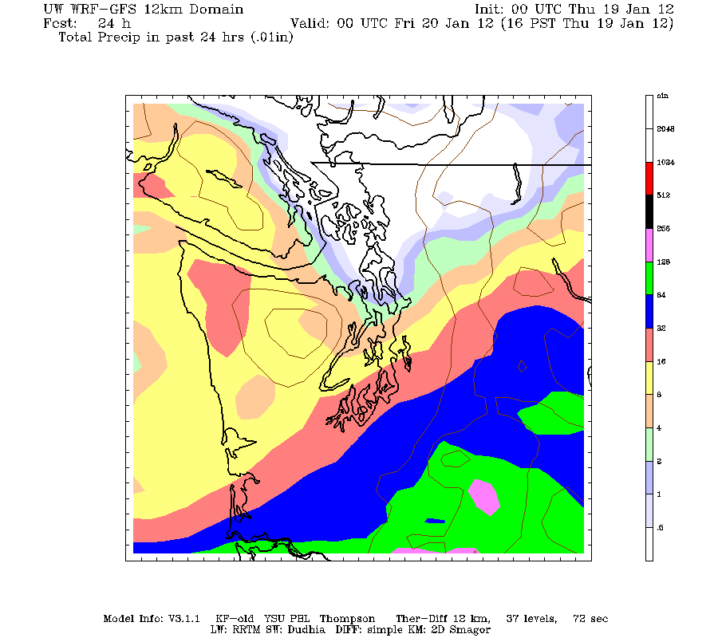
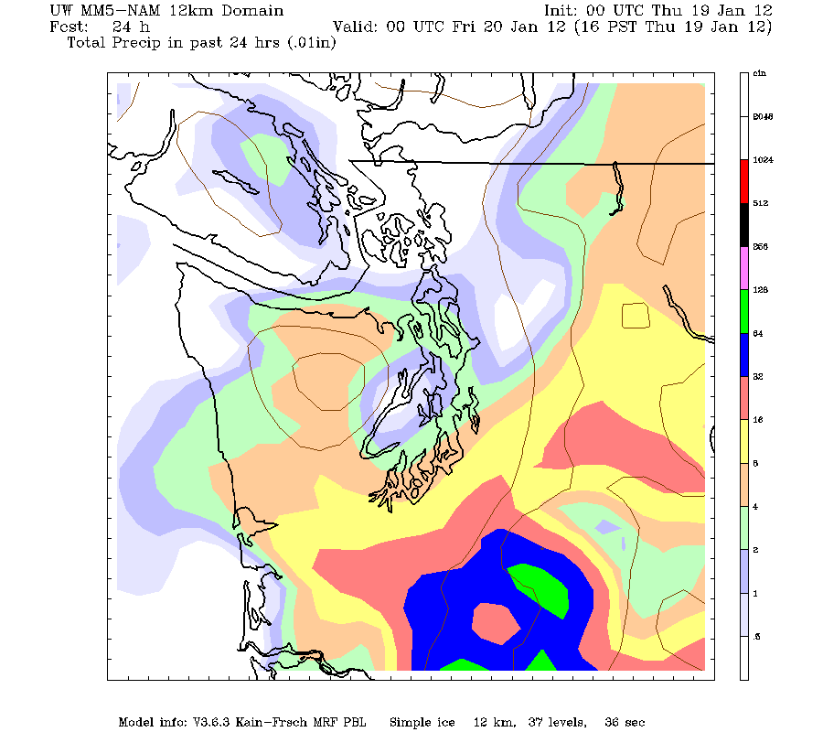
Forecasts of 24-hr accumulated precipitation ending 4 PM Thursday (00Z 20 Jan)
WRF-GFS
MM5-NAM
48-hr forecast
(Tue afternoon)
24-hr forecast
(Wed afternoon)

Slide 31
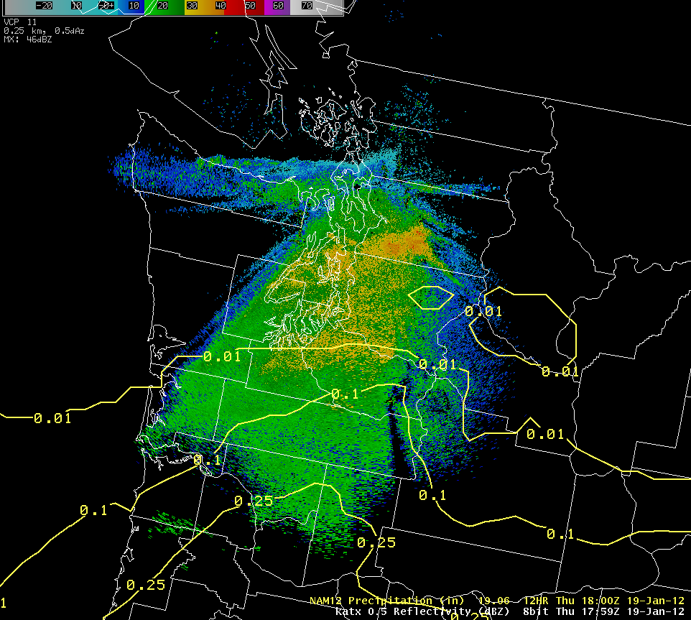
KATX 0.5 reflectivity and NAM12 12-h precipitation forecast (ending time)

Slide 32
So, in the last 20 years we’ve “modernized” our science and our forecast process. What’s next?

Slide 33
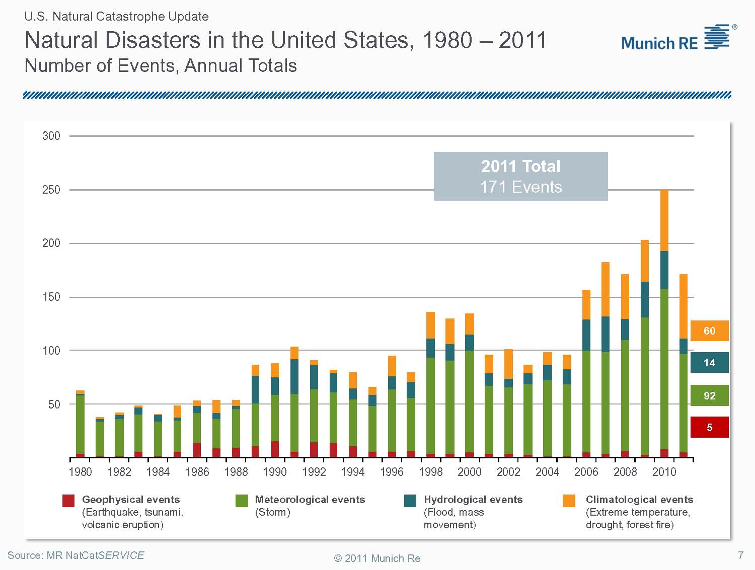
Increased Vulnerability

Slide 34
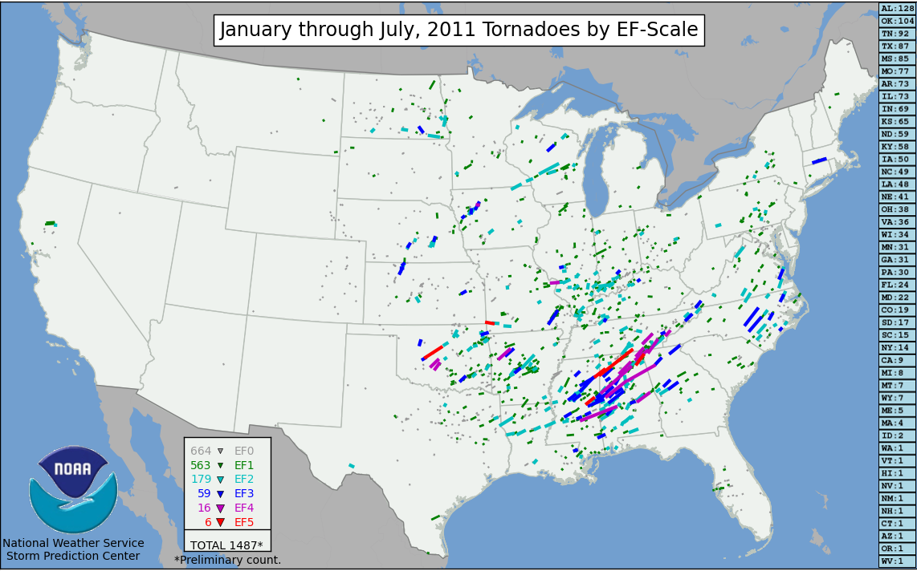
2011: A Historic Year
Multiple Tornado Disasters
Approximately 1600 tornadoes
  22 violent tornadoes (EF4 – EF5)
552 fatalities
  Thousands of serious injuries
Billions in damage
Notes:
Early in 2011 NOAA and the National Weather Service announced a strategic initiative to focus our science and services toward making America a more “Weather-Ready Nation”
At the time, little did we know what an incredible year for hazardous weather 2011 would become
This map shows just how widespread and violent the 2011 tornado season was
Your eyes are brought quickly to the southeastern US and southern plains where many serious disasters occurred
But even areas less accustomed to saw major killer tornadoes – such as Eastern North Carolina and Massachusetts

Slide 35
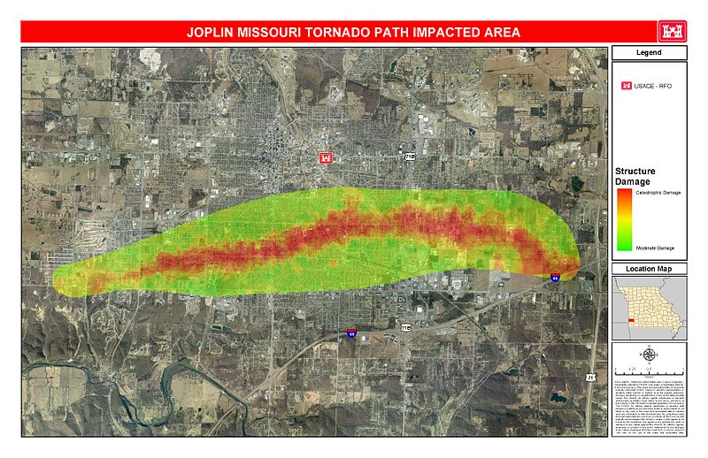
24 minutes lead time: 160 dead, 25% of Joplin destroyed, nearly 7,000 houses were destroyed (most of which were flattened or blown away)

Slide 36
Why were there so many fatalities?
People didn’t receive the warning
People ignored the warning
The tornado went in a different direction than forecast
People took the right action but died because the storm was simply too strong
People did not understand the warning

Slide 37
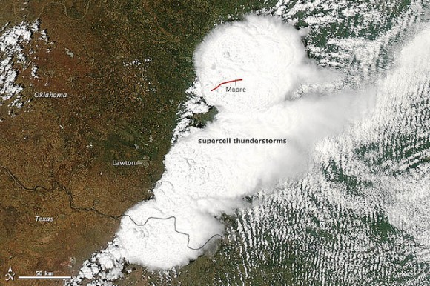
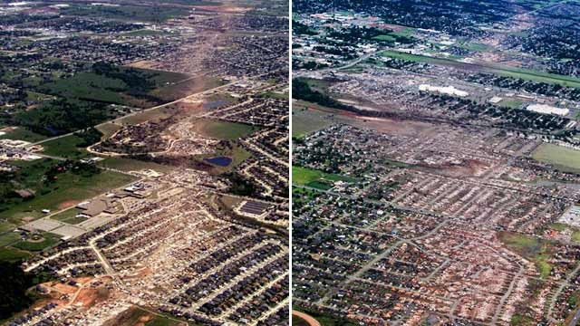
Moore, Oklahoma
Lead time 16 min
24 fatalities
“survival not just luck”
Better preparedness
30-40k visitors/year

Slide 38
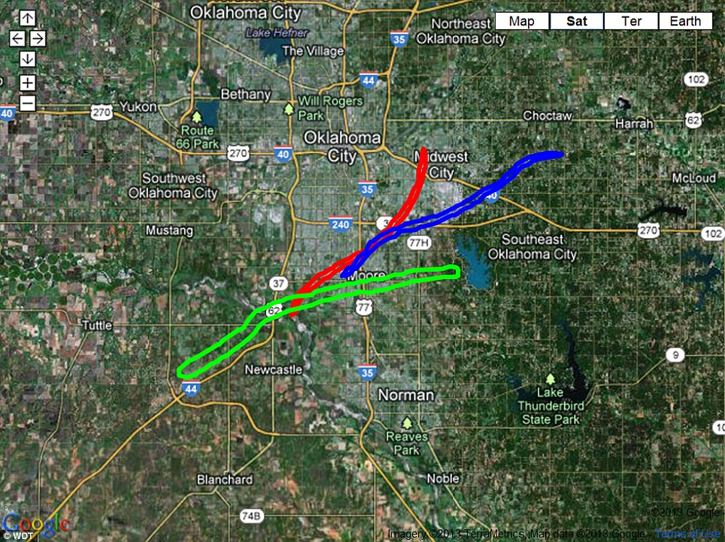
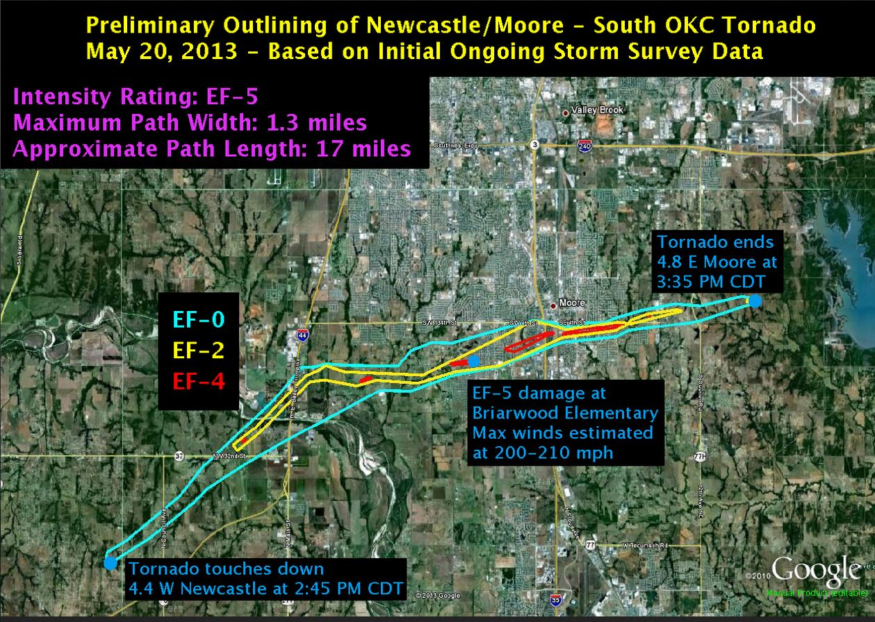

Slide 39
Decision Support Challenges
Despite science and service improvements, people are still being injured and dying unnecessarily
Society is becoming more vulnerable to extreme weather events, increasing the risk
What can the weather enterprise do better to elicit the appropriate responses in order to reduce loss of life and property?

Slide 40
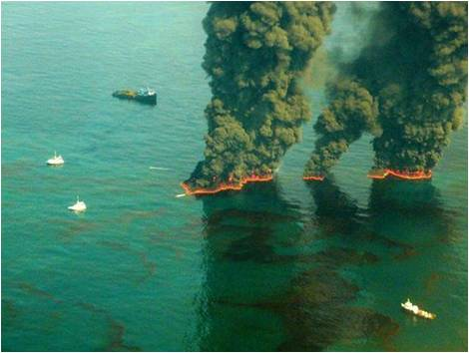
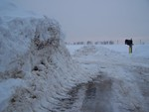
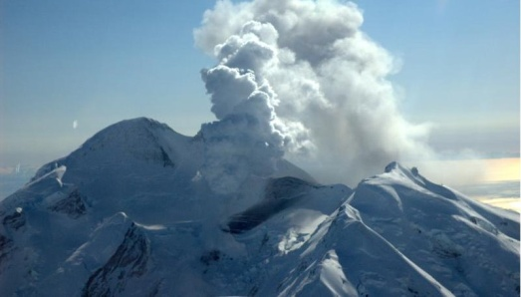
A Weather Ready Nation
Events of 2010
Deepwater Horizon Over 100 days’ deployment
“Snowmaggedon”
DC – Baltimore Paralyzed for 7 days
              Iceland Volcanic Ash
              $2B Aviation Impacts
  Even worse in 2011: Twelve $1B Weather Disasters
  Supporting these events singularly stretched NWS resources and capabilities

Slide 41
January Storm’s Impacts and IDSS
Impacts:
  Prolonged multi-hazard event (week plus)
  500,000+ without power
  Near record and record snow and ice
  Huge impacts to commerce (1 fatality; 4 missing)
IDSS:
  Tested new office operations plan
  Snow well forecast; many early actions taken
  Ice storm not so much; EAS activation
  Five email briefings, six webinars (~4000 contacts)
  Special request state-level webinar and email
  Hundreds of media contacts
  Millions of hits on web (Weather Story)

Slide 42
Careers in the NWS

Slide 43
A typical progression in the NWS for a meteorology graduate with BS or MS
MIC at field
office
All sorts of places to go…
SOO
Regional or
National
HQ
Intern
General
Forecaster
Lead
Forecaster
1
National
Center
WCM
1 - 4
5
5
Other staff at the typical field office include: hydrometeorological technicians, electronics technicians and a system administrator, information technology officer, service hydrologist, and administrative assistant. We’ve got 28 full-time staff at WFO Seattle (18 mets).
Research
Position, etc.

Slide 45
WFO Seattle Schedule

Slide 46
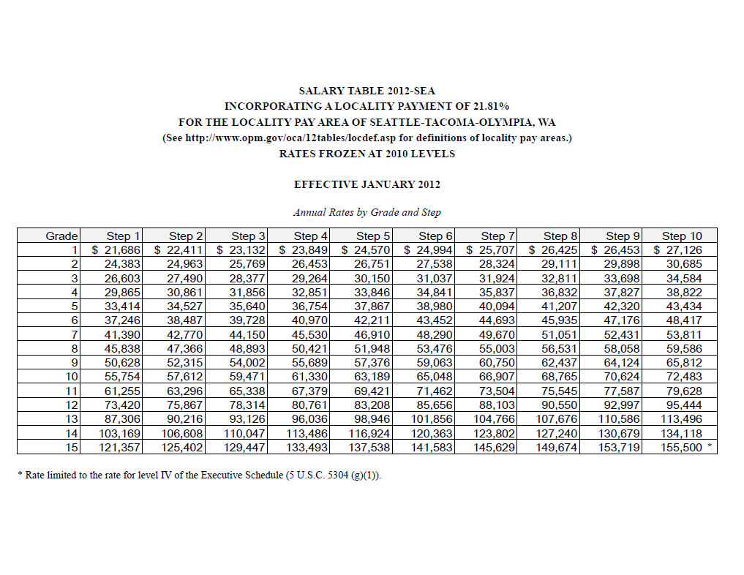
Intern (1)
Intern (3)
GF
LF
SOO/WCM
MIC

Slide 47
Summary Thoughts
The future of the NWS forecaster is to do more and more decision support
Most decision makers want someone to help them understand the impacts… at a personal level (they aren’t all that interested in the weather)
Solid scientific principles are critical and offer many opportunities
These are all important and rewarding activities

Slide 48
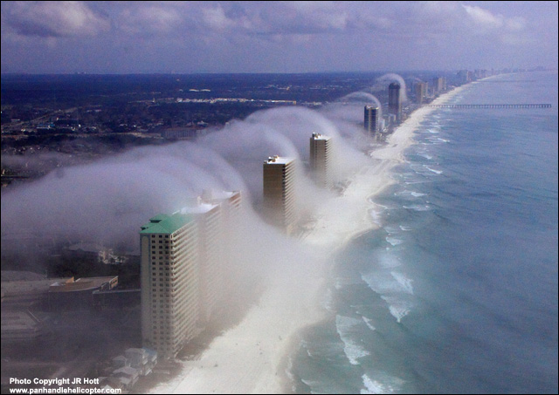
The NWS is a great
place to work!!

Slide 50
NWS S&T Priorities
Forecaster Environment
Situational Awareness
Numerical Guidance
Forecast Uncertainty
Integration of Social Science
Information Technology
Improved Science

